Slide 1
Pre-Visualisation and the Design of the Open World
Sam Howels – Deep Silver Dambuster Studios
Notes:
I’M SAM I’M GOING TO TALK ABOUT GAMES

Slide 2
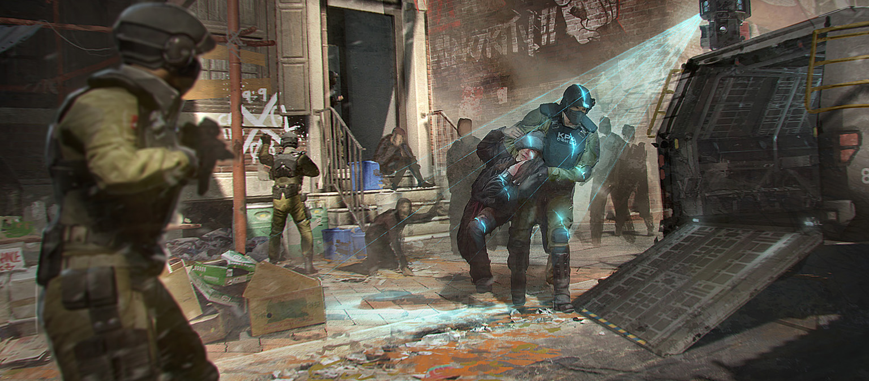
Notes:
Before I talk about pre-vis process – rundown of the game for those unaware
Sequel to Homefront which was released in 2011, was a FPS set in an near-future America invaded by KPA military forces, a premise that people responded to, fighting a war on home turf. HF:TR is still FPS, but set open world, in an occupied Philadelphia.
Game is split into a few area types with different player experiences – GZ is the opulent part of Philly including landmarks like City + Independence Hall where KPA top brass have established themselves which is where we have a lot of story missions take place,
Then we have more systemic areas the player - YZ, oppressed civilian populace locked down by KPA, living under their regime and RZ, bombed out wartorn , no-mans land area where civilians were evac’d from, KPA roaming around flushing out any signs of life, and resistance are using to assemble. This is what we showed at gamescom and pax recently, and we showed yesterday at the dambuster dev session

Slide 3
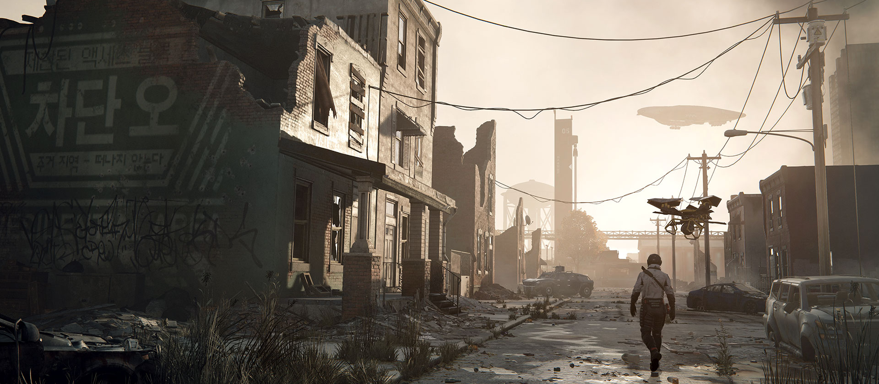
Notes:
The Red Zone is what I’ll talk about today because this time last year it was the least developed part our the open world –didn’t sell what we thought made Homefront appealing to people, and it wasn’t fun to play

Slide 4
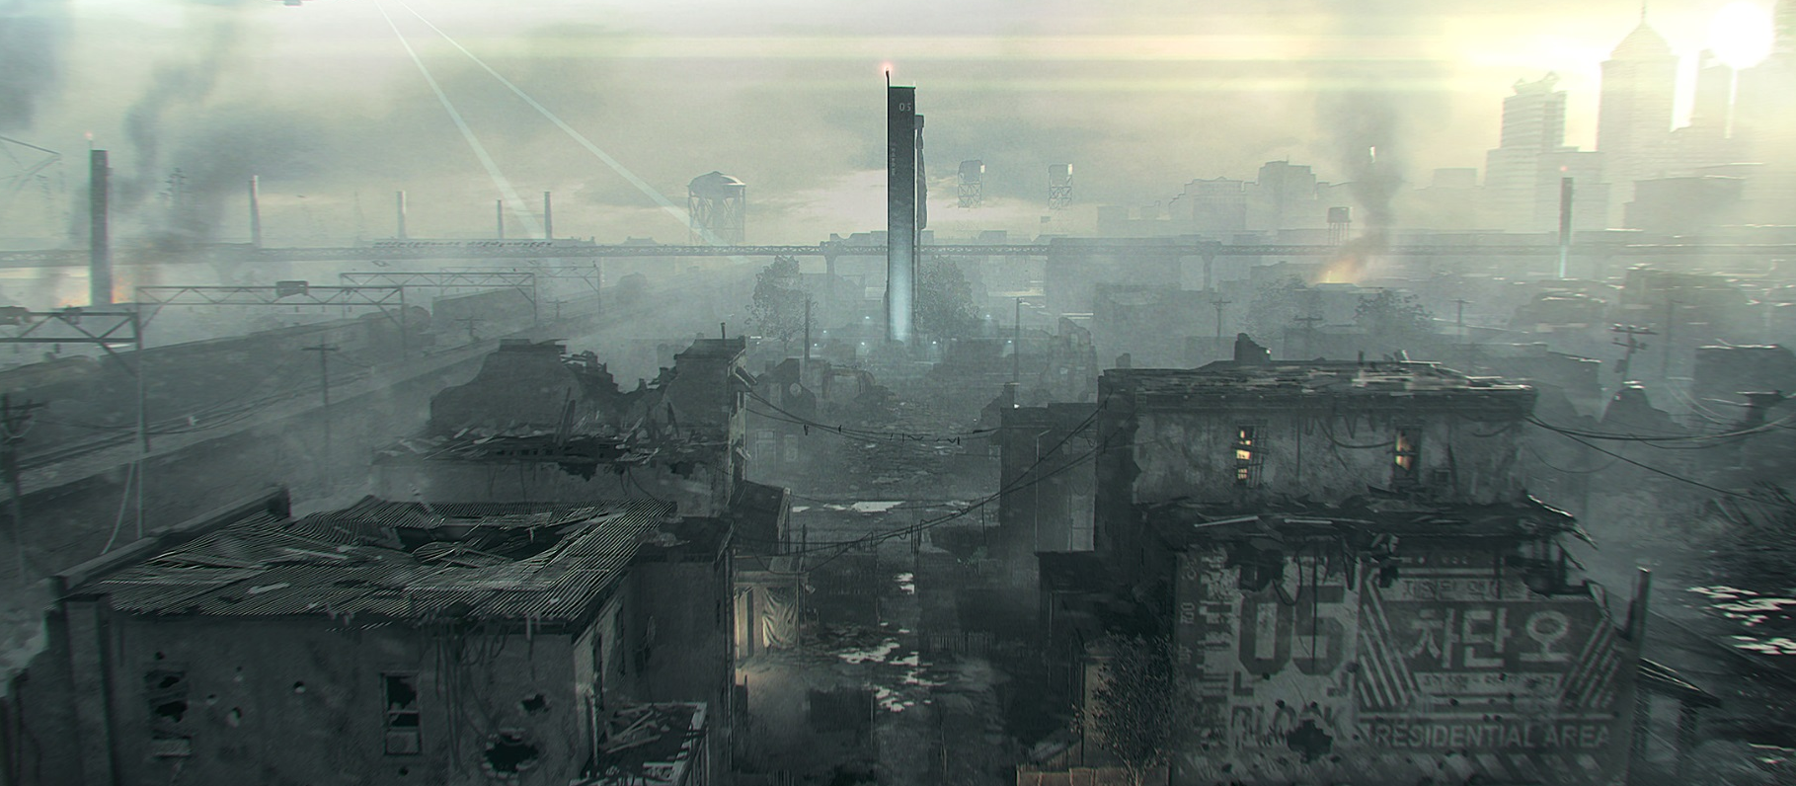
Notes:
Let’s start off where we left Red Zone as Crytek UK last E3 – what we showed of RZ was a scripted teaser, not playable, it had yet to properly translate to the whole game

Slide 5
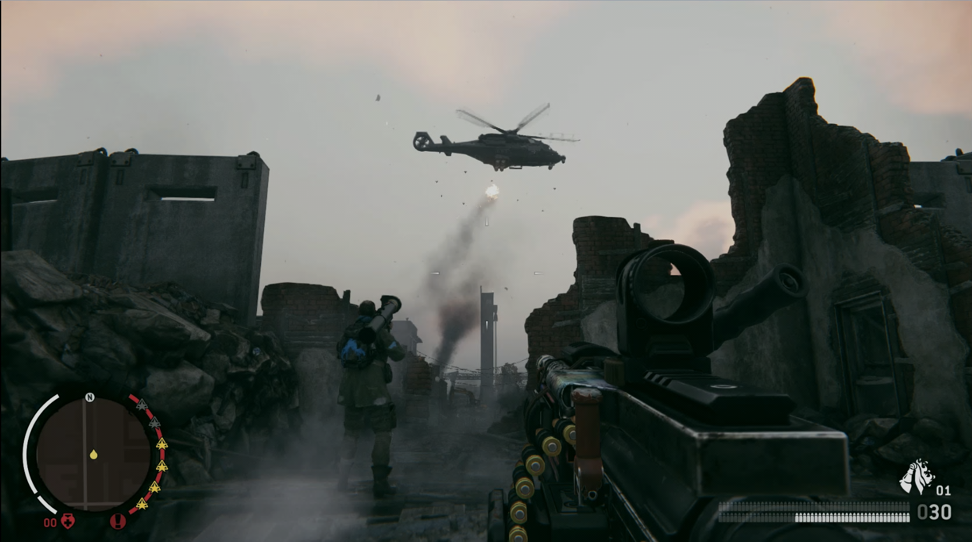
Notes:
PLAY E3 VIDEO - https://www.youtube.com/watch?v=RlT6QawiqMk
The actual in-game was RZ empty, flat, sparse, not proven
Switch to new open world genre (new to studio) had resulted in design that was unfinished and lacking – hadn’t found the fun
BUT – we were acquired by Deep Silver – given more time and resources to craft improved product

Slide 6
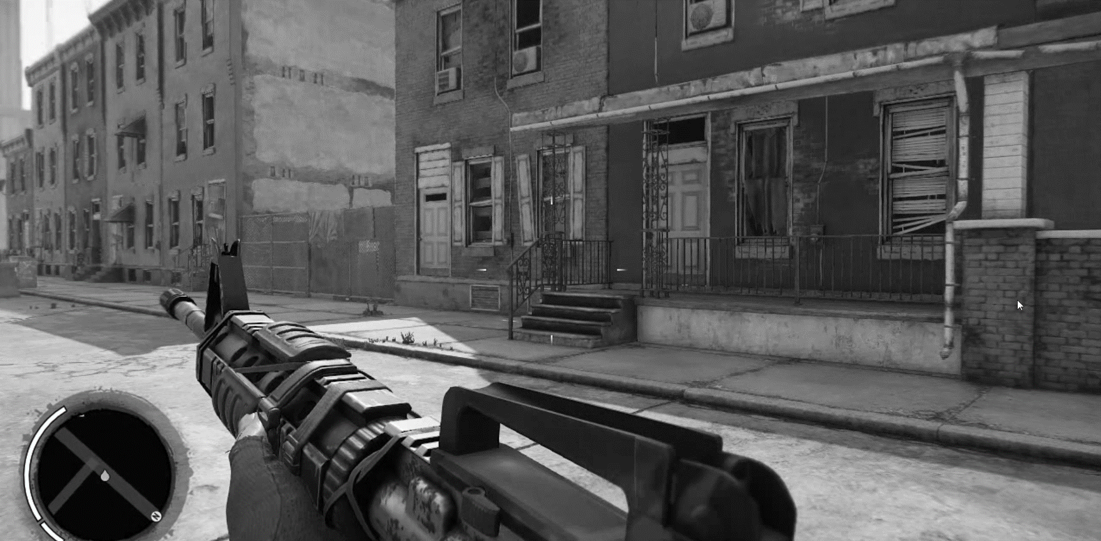
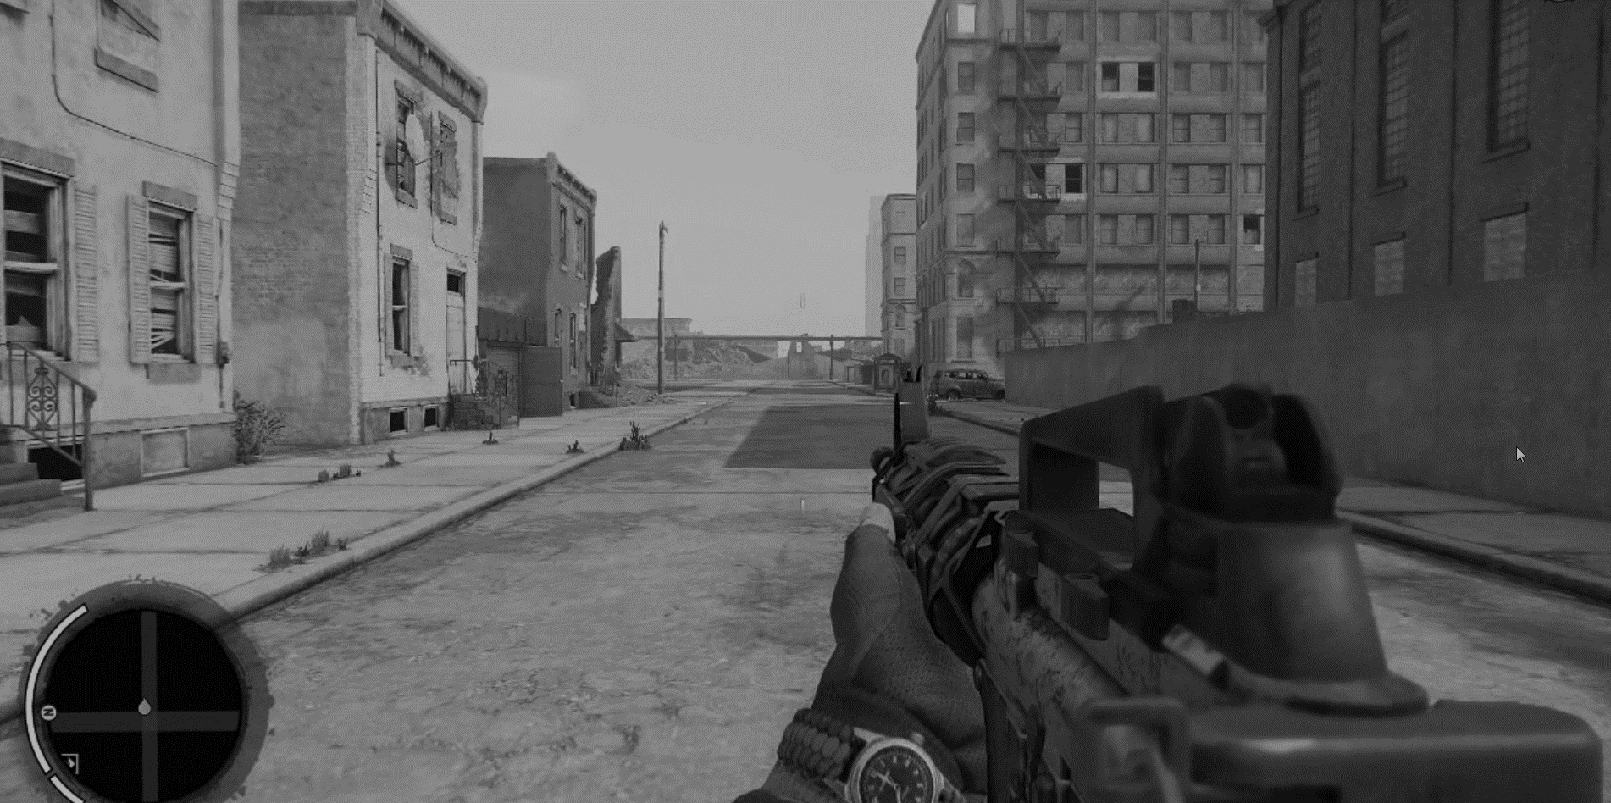
PRE-ALPHA – NOT FINAL PRODUCT
PRE-ALPHA – NOT FINAL PRODUCT
Notes:
What were specific problems?
THEMATIC ISSUES :
Occupied America – no sense of a warzone, no fear/tension, any urban conflict – player had unchallenged free roam of the world, not encouraged to think tactically
Guerrilla warfare – typically this implies inferior resistance outnumbered/outgunned by military forces and having to improvise with environment and their tactics, but signs of this weren’t present environment AND gameplay systems - one-man army
LEVEL DESIGN ISSUES (not just homefront problems, FPS problems):
Flat and grid-like –enemies blend into one mess on screen, huge long lines of sight, combat leaks between streets – wasn’t fun or interesting
Options - very few interiors, verticality options ended up as dead ends - no combat or exploration options for the player

Slide 7
Notes:
SO – we made a pre-vis.
You might think – why not prototype? Why not make something playable and improve from there?
This is one of the areas where working on open world differs in my mind – to create a playable open world, everything needs to be a functional system – expensive, time consuming
Pre-vis (presented as in-game footage) allows you to explore mechanics and atmosphere at fraction of the time and cost

Slide 8
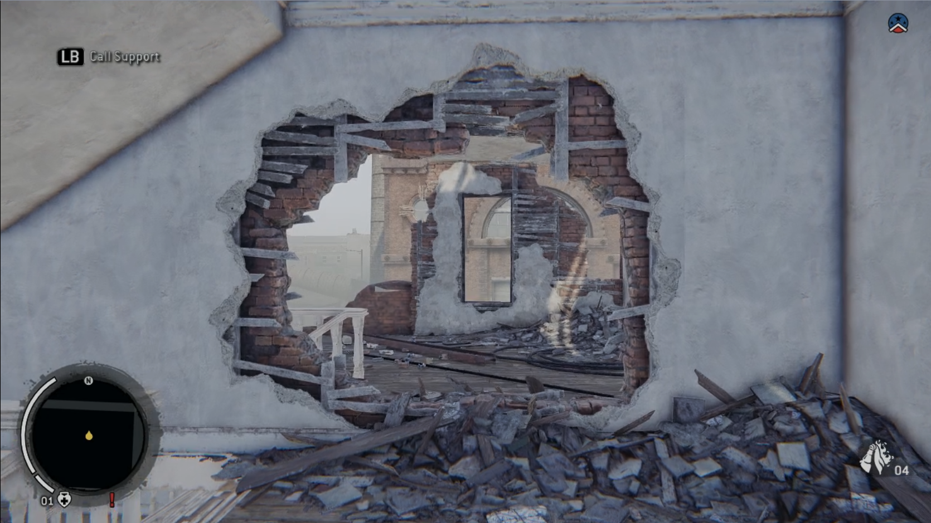
Notes:
Created a year ago, in the same build as the last video:
Bottom left is pre-vis, top right is footage captured in gamescom build
PLAY PRE-VIS VIDEO - https://www.youtube.com/watch?v=YLwpdx-I3po:
First thing you see – start in an interior, showing war torn environment. Instantly get a sense of the state of the world and what people are using it for
Atmospherics – had no fog/particles in world before, helps sell the urban battle-dust feeling, reduces LoS, gives world a sense of depth
Airship/patrols – threats, drive player off the streets
Ambient resistance – them moving around the streets, using interiors, fighting KPA – shows the player is not alone in the fight and creates emergent events
Looting vehicles – KPA patrols should be ambient goals for the player, promoting engagements
Snipers – brand new mechanic, also drives the player off the streets
Resistance support – this implementation didn’t make it in but we have a lighter version in the final game

Slide 9
IGN - ”the concept of playing cat and mouse with a force way stronger than yours is definitely one I find interesting.”
Eurogamer - “it's unwise to take on a patrol with more than a couple of soldiers, the wiser option being to pick them off one by one or, even better, simply stay out of their sights.”
Escapist – “Engaging with foes for too long means they'll soon have backup and your scrappy band of resistance fighters will be even more outgunned.”
Eurogamer – “snipers sit at every corner, and it's a case of inching your way out, darting between cover before scrambling up behind them to take them out”
IGN – “It's better to retreat back into the cover of the buildings and plan your next strike.”
GamesRadar - “ Action takes place in speedy bursts before you quickly retreat and evade enemy fire. Feel like you're surrounded? You probably are, so you should run.”
IGN - ” take out the handful of soldiers who've spotted you, then move on before more turn up, otherwise you face getting pinned down..”
Notes:
From that you should get a sense of the direction we were looking to take Red Zone
You can see the difference between the screenshots of bad RZ, to pre-vis made in the same build, and how the final game was informed by the work done
In terms of the problems we were trying to solve, the press have validated the work we’ve done – quotes above

Slide 10
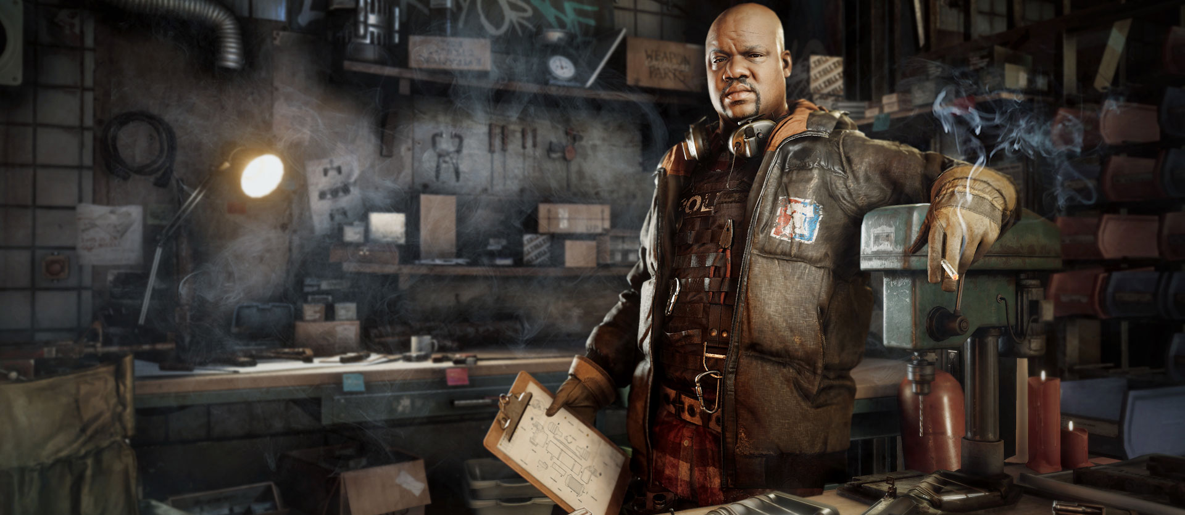
Notes:
TAKEAWAYS
Previs can be a cheap and effective option to focus ideas especially for large systemic projects like an open world game
Why I think this is relevant to EGX crowd - this can be done by anyone with an idea. Even if not in the industry, barrier for entry on making a video asset of a game is very low with so many free tools – if you have an idea for something, you can write as many words as you want, but seeing something tangible can inspire people in ways that emails or forum posts can’t. if you have an idea, make something that shows it, and maybe you’ll be able to play it one day

